Slide 1
A Case Study of Impact

Slide 2
Tourism Tracer: What we did
We designed visitor tracking research using adaptable technology
We used integrated GIS and survey technology, resulting in incredibly accurate movement & demographic data
We pioneered new modes of analysis and visualization, including on our Tourism Tracer Dashboards.

Slide 3
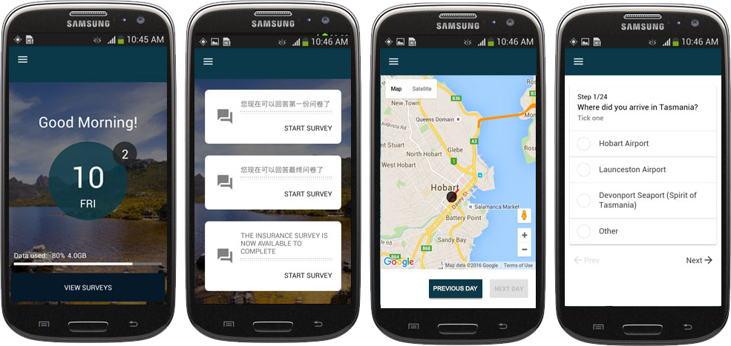
Notes:
What we do
Started Tasmania 2016- recruited 500 at 3 entry points-
App on a mbile phone bc poor WiFi- English and Chinese
Incentives:
Free data
TourTracer map
So popular we continued in 2017
Tasmania: handsets – 1000 tourists til March 2018
Tasmania: also launching Standalone app- launching Dec 15- with social media synced Tour Tracer map
Sweden: Tourism Skane – our tech on back of an app- using closed source library
This option works well in contexts such as attractions, hotels, ski resorts, museums or in destinations where visitors all tend to arrive and depart via one entry/exit point, in terms of managing the logistics of giving out and collecting the phones.

Slide 4
Freycinet National Park Case Study
Average time at lookout 13 mins
47% of phones then continued on to edge of beach
23% of phones were then recorded on beach itself
Notes:
Introductions:
Famous for beaches. 2 major walks:
Lookout
Loop
Massive rise in numbers
2012/2013 = 191,000
2016/ 2017 = 292,000
Annual growth rate 11.2% - expected to go over 300K this sum
As a result have funded a Freycinet Management plan for entire peninsula including the national park crown land and township
Overall Figures regarding Peninsula
43% stay less than 5 hours on the peninsula
61% stay less than 10hrs
Bushwalkers
Visitors from Australia and mainland China were less likely to do a walk – e.g. only 35% Chinese did a walk ; whereas 61% Hong Kong did one
Visitors from Hong Kong and other places of residence were more likely to do a walk
61% those aged 18-29 did a walking compared to 28% of 60+

Slide 5
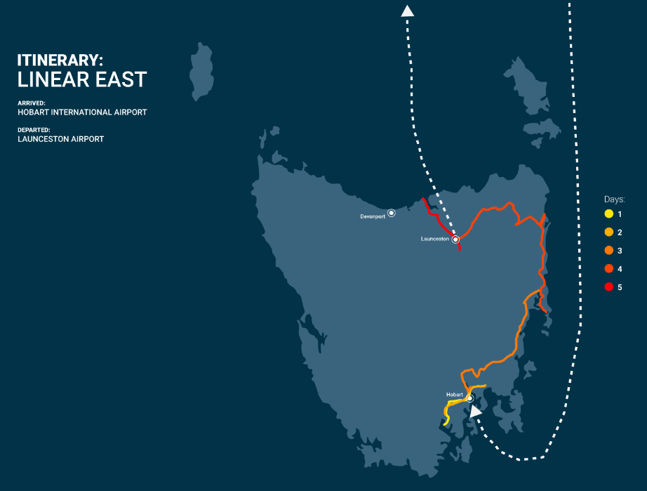
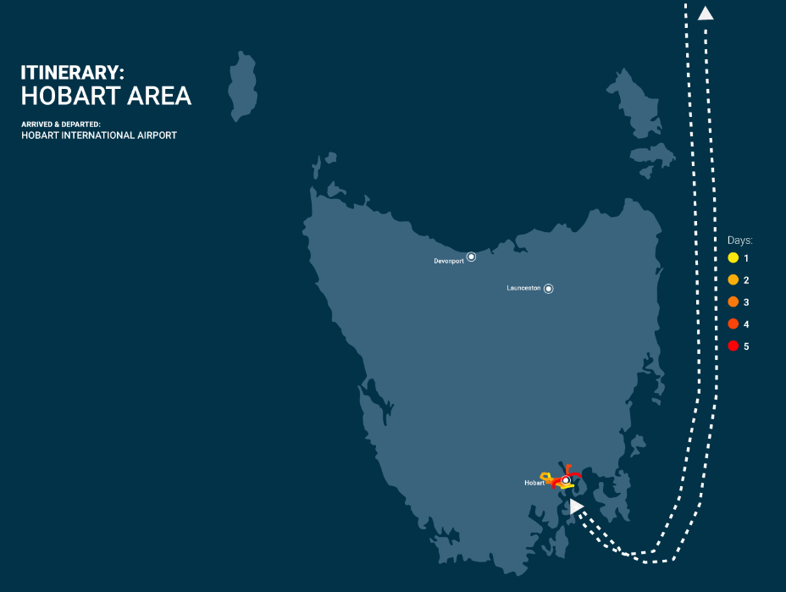
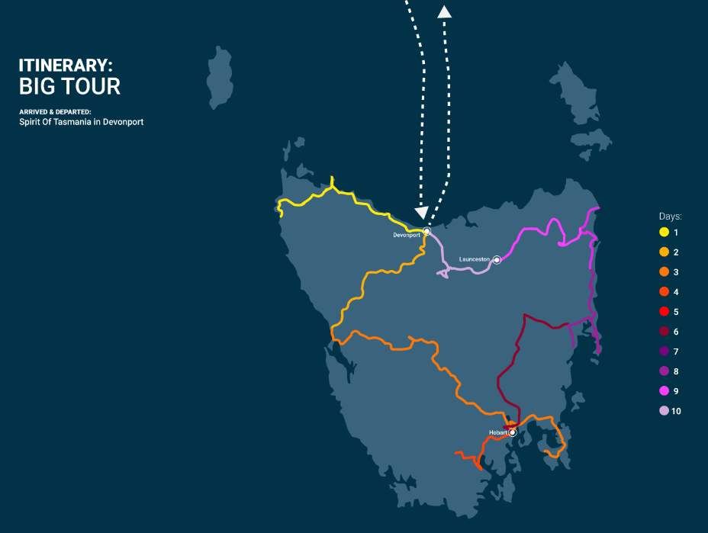
How data can affect policy: Itineraries
Notes:
How did it help?
How did it relate to policy? Tasmanian Experience Strategy -
Dispersal – target 66% how far according to distance
We have data on :
First and last night- dispersal on the first night
Speed- reducing risk on roads-
Late night driving – 13% between 11pm and 6am
Linear East- 6.8 days
51 % In Hobart, out Launceston
29% in Launceston, out Hobart
ONLY 13% in and out through Hobart-
1st time visitors
Tasmania as the main but not the only destination
Car/4WD
Motorbike, bicycle, bus
Hobart Area – 4.4 Days
Repeat visitors
Those with no transport
Big Tour- 11 days
More likely to be 18-29 and 40-49
52% in and out of Devonport
38% in and out of Hobart
More likely to be first time visitors
Been somewhere else before- more likely to be 1st time visitors

Slide 6
How we created industry impact
Industry focused research questions
Advisory board of industry leaders
Two teams of researchers: academic and industry focused
Alternative modes of communication of results
Blog with data insights; Twitter; Facebook; You Tube
Data dashboard with no graphs
Awards
National and Tasmania
Media
Print, radio and TV over 45 appearances
Stories plus opinion editorials

Slide 7
www.tourismtracer.com

Slide 8
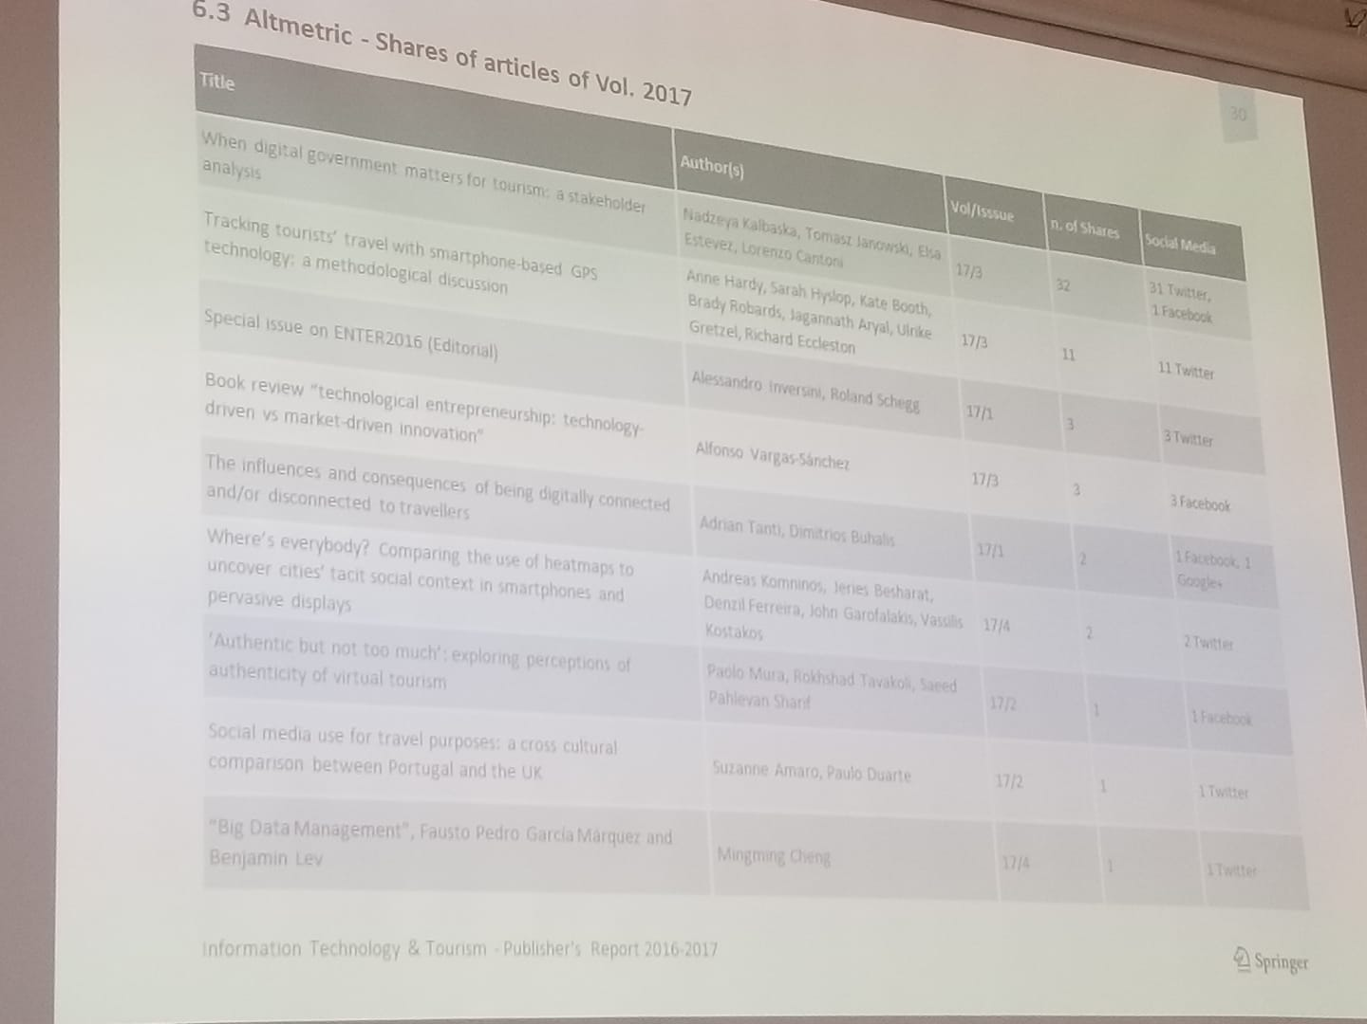
How we created academic impact
Previous methods
Papers
Use of altmetrics
Twitter, facebook
Conferences

Slide 9
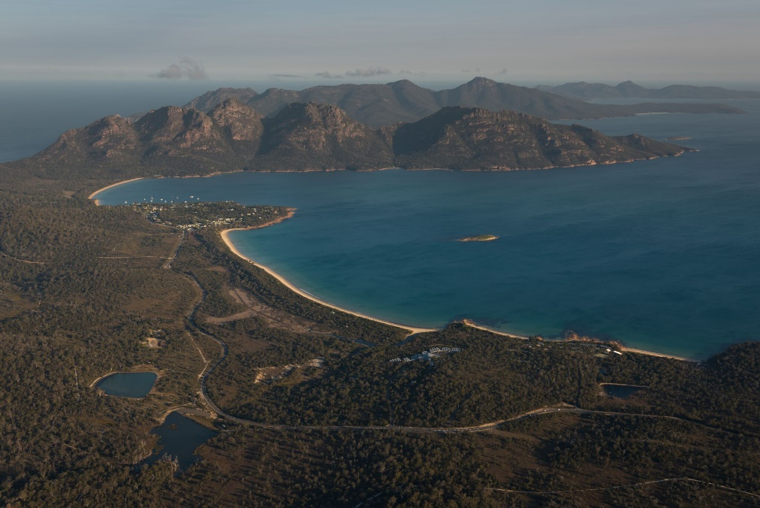
Outcomes of all this
Review of government's policy into Tourism research
Request for detailed data in Tasmania
Road safety
Freycinet Management Plan
Clarence Council Eco’c Dev Strategy
Tasmanian Visitor Engagement Strategy
Contract in Sweden
Inclusion in strategies
Invites to UN WTO; keynotes at VTIC, TICT plus regional conferences
Car Park : 292,000 p/a
Peak time 11am-2.30pm
average stay 1.89hrs
average stay during peak: 2.3 hrs

Slide 10
Research Impact
Defining Research Impact (Australian Research Council)
Research impact is the demonstrable contribution that research makes to the economy, society, culture, national security, public policy or services, health, the environment, or quality of life, beyond contributions to academia.

Slide 11
Creating Impact: What does your academic and industry body want?
Read, read, read
Listen listen listen!
If you want to create impact, you need to know what the problem is that needs solving
Impactful research makes a difference and hinges on good communication
This can be problematic – and not necessary- for theoretical/ conceptual research
ALWAYS consider your language

Slide 12
Our Impact Matrix
Stakeholder | Style of Contact (academic/ laypersons terms etc) | Method of Contact | Frequency of Contact
Notes:
Your examiners- acadeamic langague!
Your research peers (hons, TSBE, UTAS and beyond)
Ethic Committee
Your participcants
Your industry body
who are the key stakeholders in that

